Slide 1

332:479 Concepts in VLSI
Design
Lecture 11
Combinational Circuits
David Harris
Harvey Mudd College
Spring 2004

Slide 2
Outline
Bubble Pushing
Compound Gates
Logical Effort Example
Input Ordering
Asymmetric Gates
Skewed Gates
Best P/N ratio
Summary
Material from: CMOS VLSI Design,
by Weste and Harris, Addison-Wesley, 2005

Slide 3
Example 1
module mux(input s, d0, d1,
output y);
assign y = s ? d1 : d0;
endmodule
1) Sketch a design using AND, OR, and NOT gates.

Slide 4
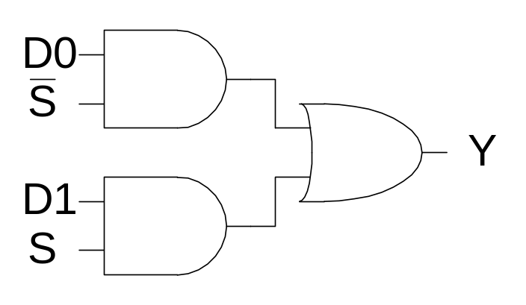
Example 1
module mux(input s, d0, d1,
output y);
assign y = s ? d1 : d0;
endmodule
1) Sketch a design using AND, OR, and NOT gates.

Slide 5
Example 2
2) Sketch a design using NAND, NOR, and NOT gates. Assume ~S is available.

Slide 6
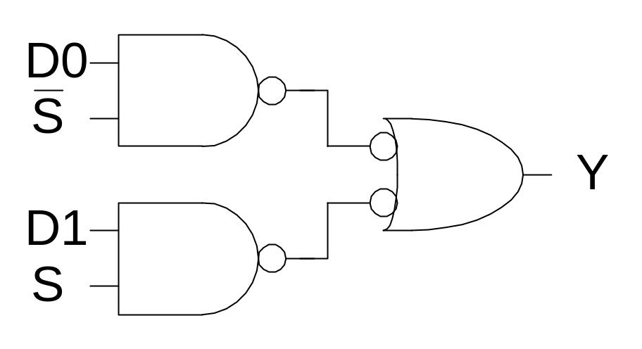
Example 2
2) Sketch a design using NAND, NOR, and NOT gates. Assume ~S is available.

Slide 7
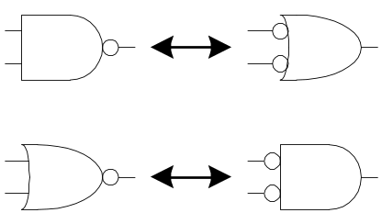
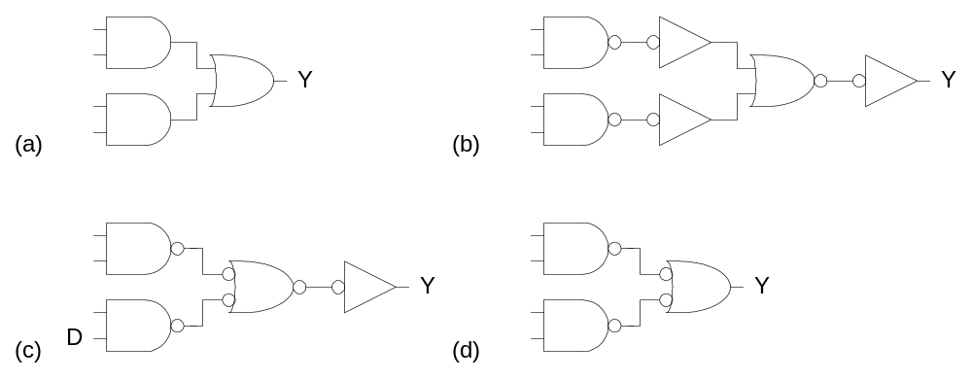
Bubble Pushing
Start with network of AND / OR gates
Convert to NAND / NOR + inverters
Push bubbles around to simplify logic
  Remember DeMorgan’s Law

Slide 8
Example 3
3) Sketch a design using one compound gate and one NOT gate. Assume ~S is available.

Slide 9
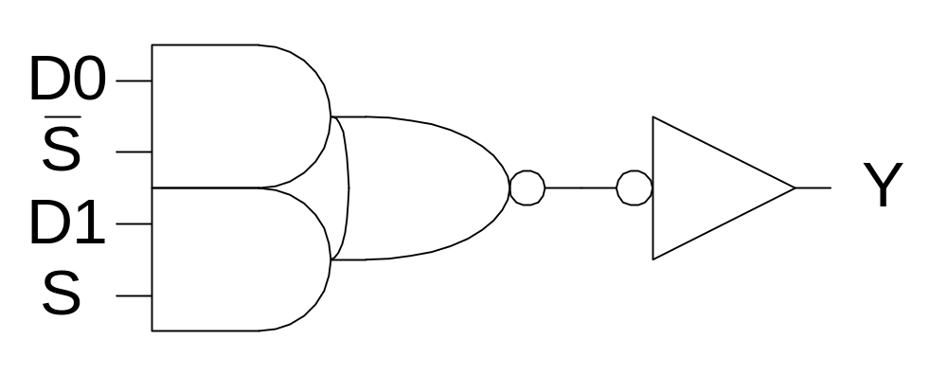
Example 3
3) Sketch a design using one compound gate and one NOT gate. Assume ~S is available.

Slide 10
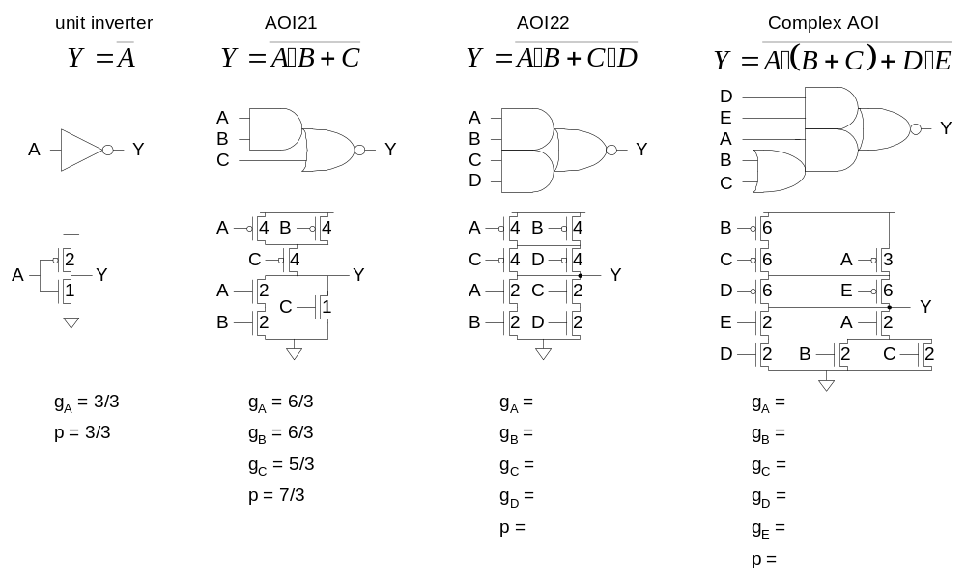
Compound Gates
Logical Effort of compound gates

Slide 11
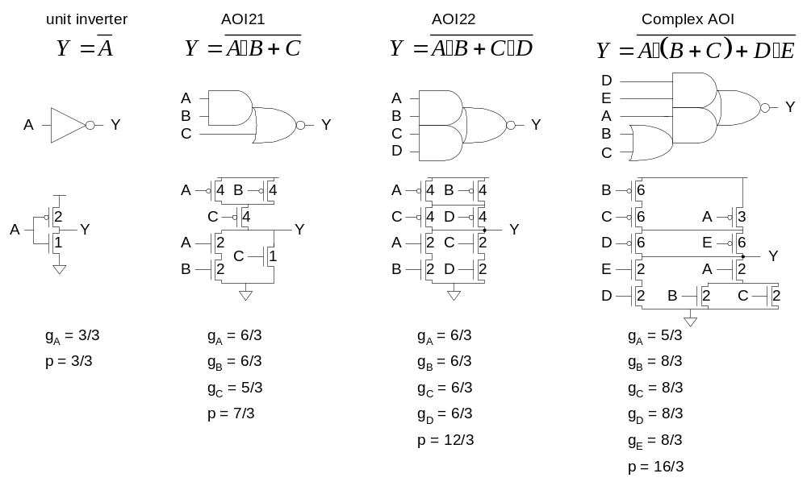
Compound Gates
Logical Effort of compound gates

Slide 12
Example 4
The multiplexer has a maximum input capacitance of 16 units on each input. It must drive a load of 160 units. Estimate the delay of the NAND and compound gate designs.

Slide 13
Example 4
The multiplexer has a maximum input capacitance of 16 units on each input. It must drive a load of 160 units. Estimate the delay of the NAND and compound gate designs.
H = 160 / 16 = 10
B = 1
N = 2

Slide 14
NAND Solution

Slide 15
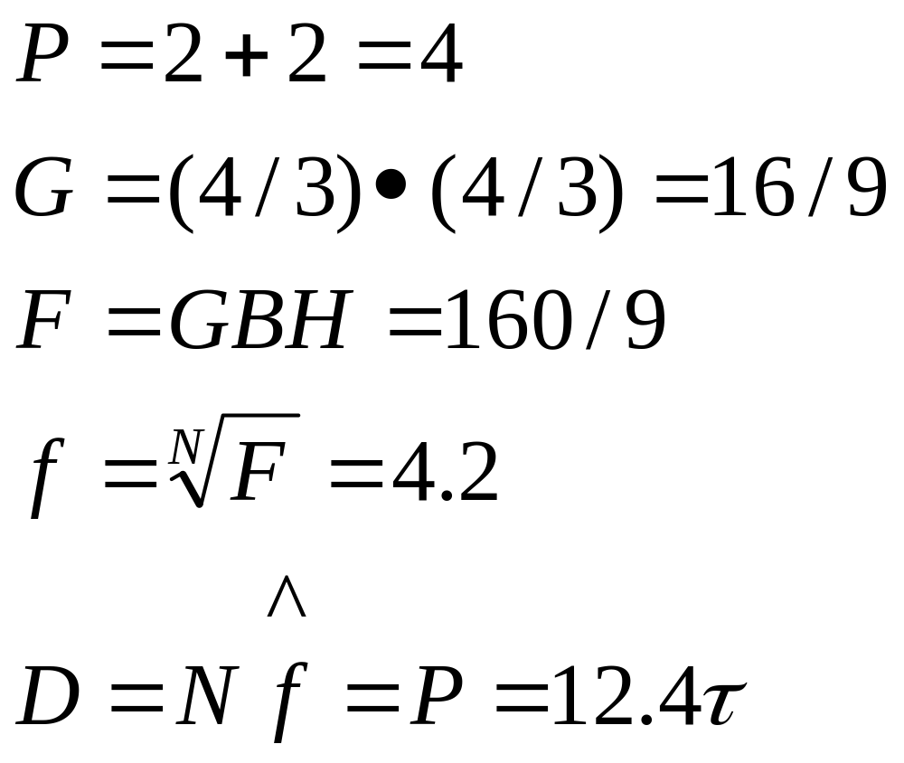
NAND Solution

Slide 16
Compound Solution

Slide 17
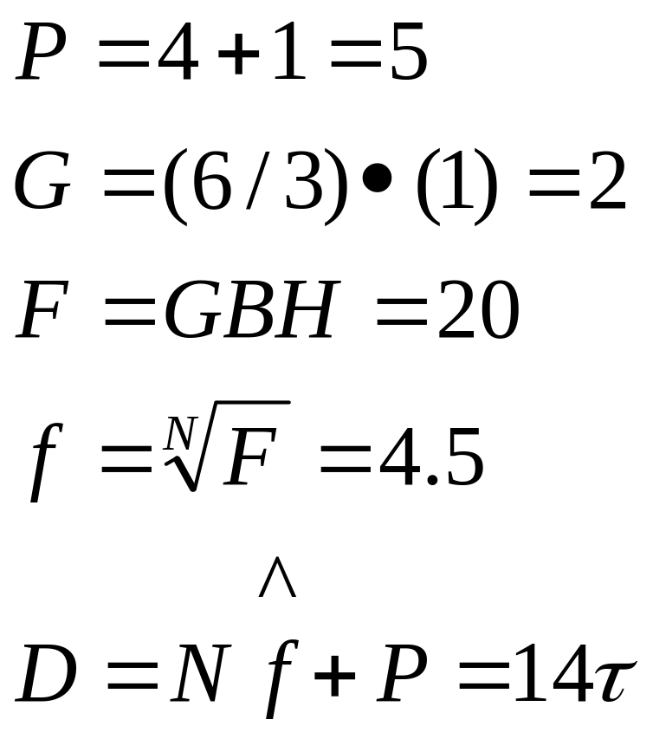
Compound Solution

Slide 18
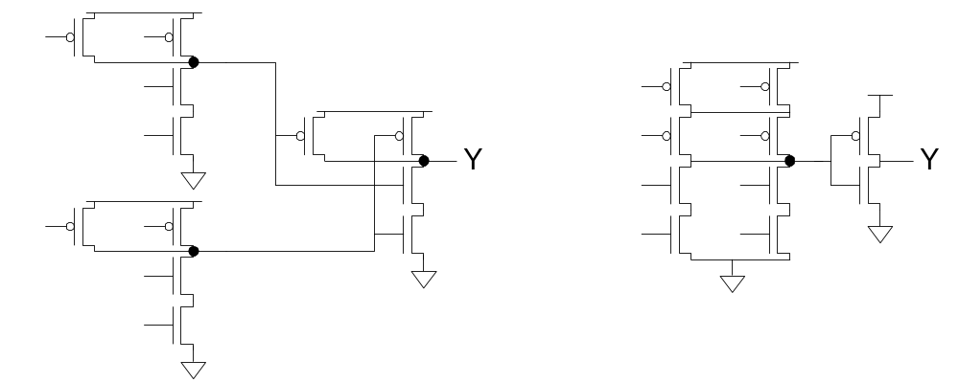
Example 5
Annotate your designs with transistor sizes that achieve this delay.

Slide 19
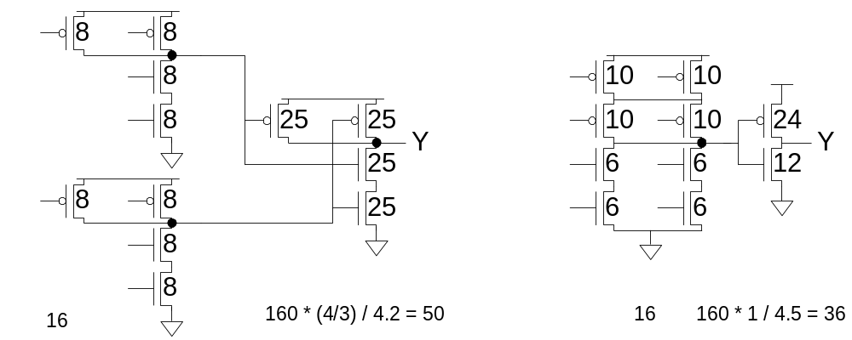
Example 5
Annotate your designs with transistor sizes that achieve this delay.

Slide 20
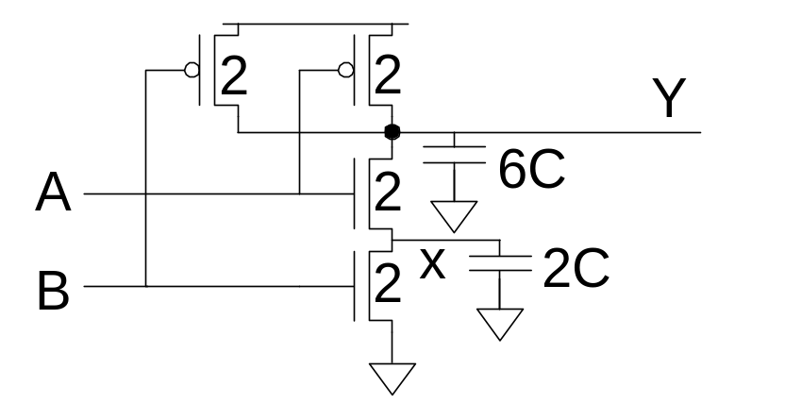
Input Order
Our parasitic delay model was too simple
  Calculate parasitic delay for Y falling
    If A arrives latest?
    If B arrives latest?

Slide 21
Input Order
Our parasitic delay model was too simple
  Calculate parasitic delay for Y falling
    If A arrives latest? 2τ
    If B arrives latest? 2.33τ

Slide 22
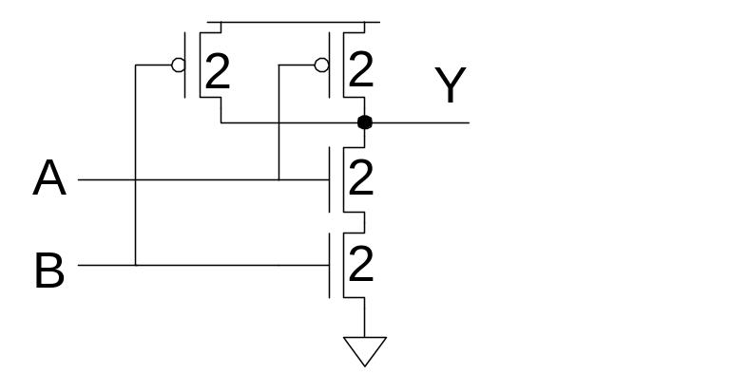
Inner & Outer Inputs
Outer input is closest to rail (B)
Inner input is closest to output (A)
If input arrival time is known
  Connect latest input to inner terminal

Slide 23
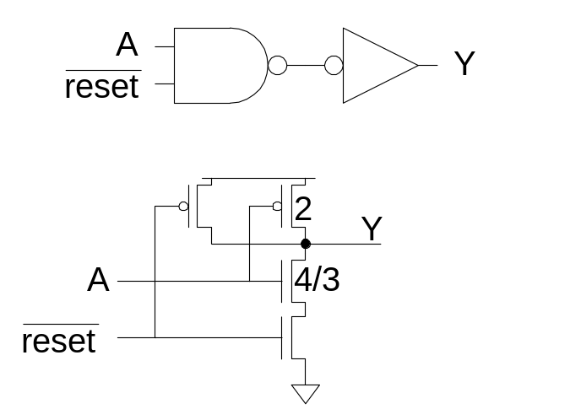
Asymmetric Gates
Asymmetric gates favor one input over another
Ex: suppose input A of a NAND gate is most critical
  Use smaller transistor on A (less capacitance)
  Boost size of noncritical input
  So total resistance is same
g_{A} =
g_{B} =
g_{total} = g_{A} + g_{B} =
Asymmetric gate approaches g = 1 on critical input
But total logical effort goes up

Slide 24

Asymmetric Gates
Asymmetric gates favor one input over another
Ex: suppose input A of a NAND gate is most critical
  Use smaller transistor on A (less capacitance)
  Boost size of noncritical input
  So total resistance is same
g_{A} = 10/9
g_{B} = 2
g_{total} = g_{A} + g_{B} = 28/9
Asymmetric gate approaches g = 1 on critical input
But total logical effort goes up

Slide 25
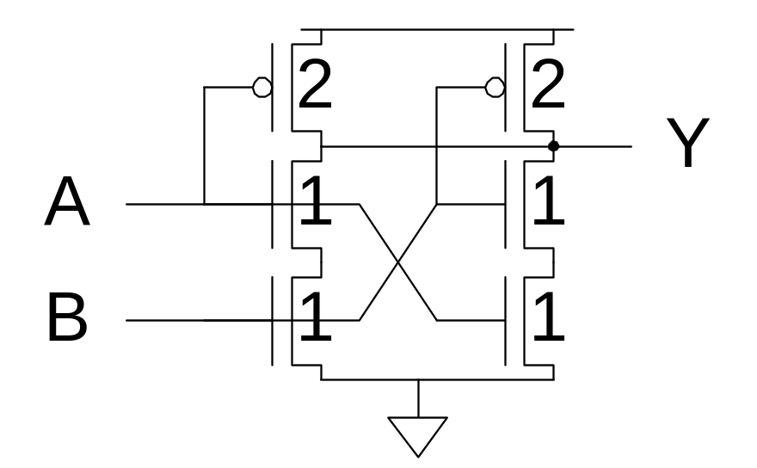
Symmetric Gates
Inputs can be made perfectly symmetric

Slide 26
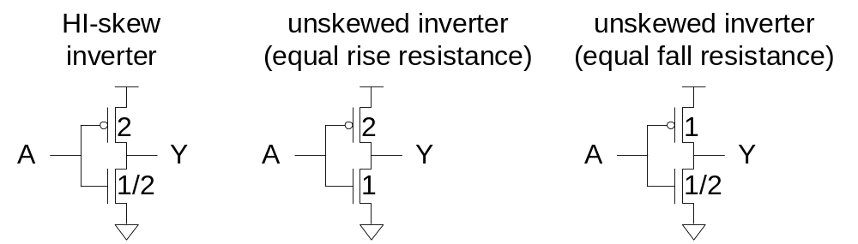
Skewed Gates
Skewed gates favor one edge over another
Ex: suppose rising output of inverter is most critical
  Downsize noncritical nMOS transistor
Calculate logical effort by comparing to unskewed inverter with same effective resistance on that edge.
  g_{u} =
  g_{d} =

Slide 27
Skewed Gates
Skewed gates favor one edge over another
Ex: suppose rising output of inverter is most critical
  Downsize noncritical nMOS transistor
Calculate logical effort by comparing to unskewed inverter with same effective resistance on that edge.
  g_{u} = 2.5 / 3 = 5/6
  g_{d} = 2.5 / 1.5 = 5/3

Slide 28
HI- and LO-Skew
Def: Logical effort of a skewed gate for a particular transition is the ratio of the input capacitance of that gate to the input capacitance of an unskewed inverter delivering the same output current for the same transition.
Skewed gates reduce size of noncritical transistors
  HI-skew gates favor rising output (small nMOS)
  LO-skew gates favor falling output (small pMOS)
Logical effort is smaller for favored direction
But larger for the other direction

Slide 29
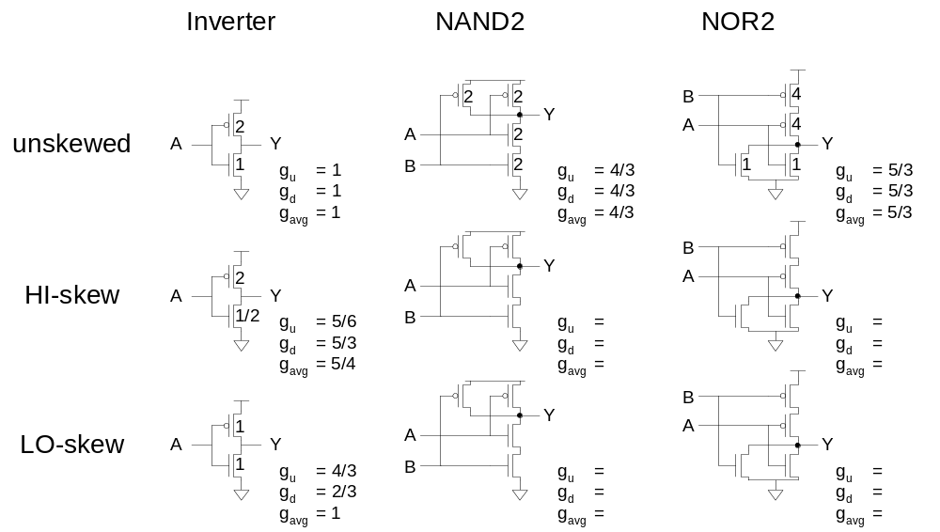
Catalog of Skewed Gates

Slide 30
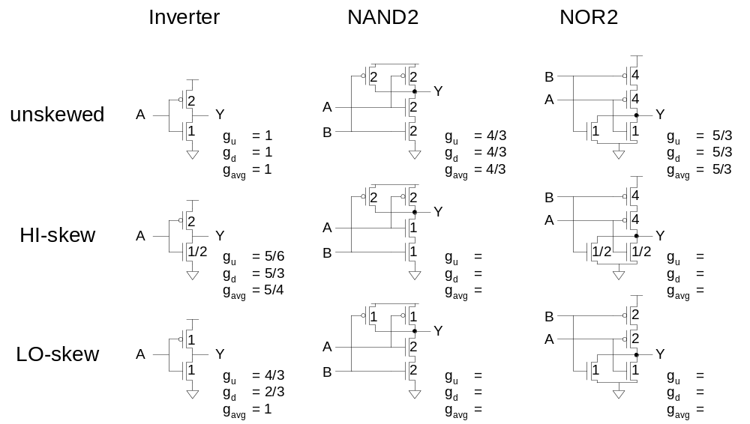
Catalog of Skewed Gates

Slide 31
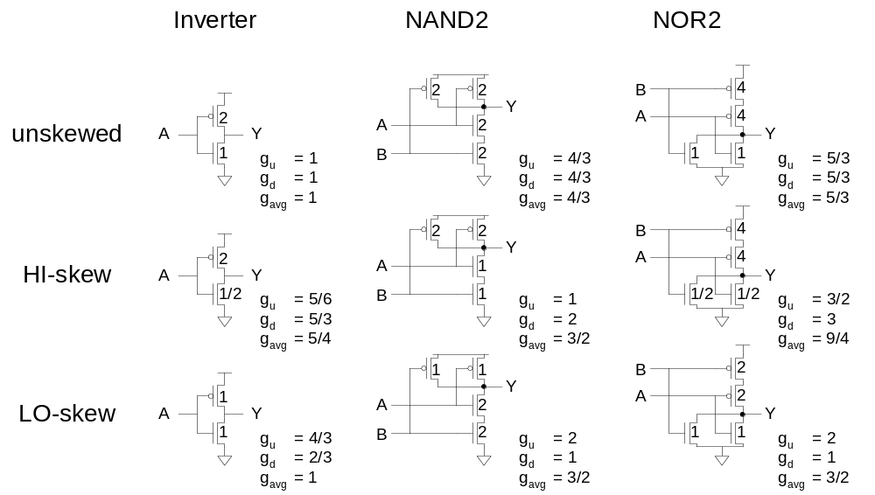
Catalog of Skewed Gates

Slide 32

Asymmetric Skew
Combine asymmetric and skewed gates
  Downsize noncritical transistor on unimportant input
  Reduces parasitic delay for critical input

Slide 33
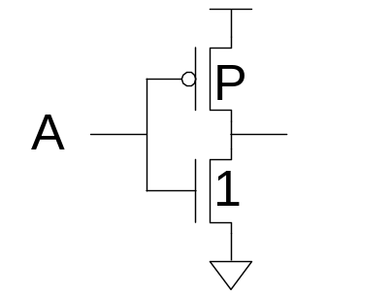
Best p/n Ratio
We have selected p/n ratio for unit rise and fall resistance (μ = 2-3 for an inverter).
Alternative: choose ratio for least average delay
Ex: inverter
  Delay driving identical inverter
  t_{pdf} =
  t_{pdr} =
  t_{pd} =
  Differentiate t_{pd} w.r.t. P
  Least delay for P =

Slide 34
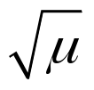
Best p/n Ratio
We have selected p/n ratio for unit rise and fall resistance (μ = 2-3 for an inverter).
Alternative: choose ratio for least average delay
Ex: inverter
  Delay driving identical inverter
  t_{pdf} = (P+1)
  t_{pdr} = (P+1)(μ/P)
  t_{pd} = (P+1)(1+μ/P)/2 = (P + 1 + μ + μ/P)/2
  Differentiate t_{pd} w.r.t. P
  Least delay for P =

Slide 35
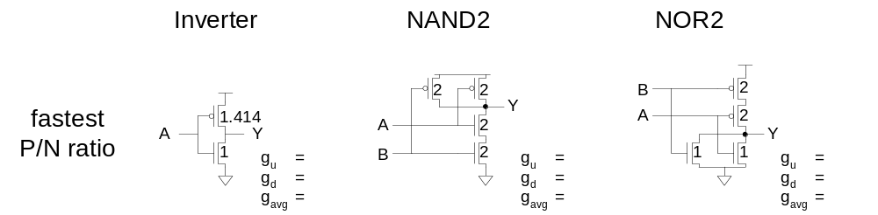
p/n Ratios
In general, best p/n ratio is sqrt of equal delay ratio.
  Only improves average delay slightly for inverters
  But significantly decreases area and power

Slide 36
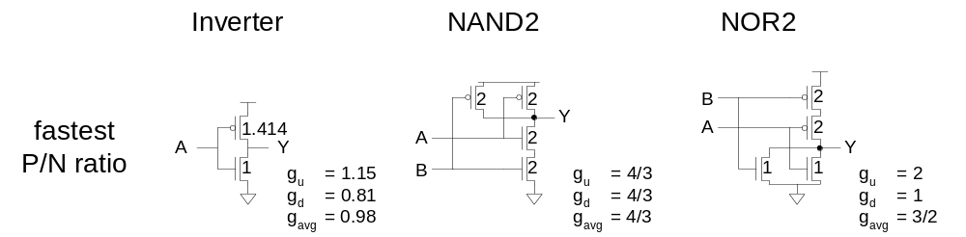
p/n Ratios
In general, best p/n ratio is sqrt of that giving equal delay.
  Only improves average delay slightly for inverters
  But significantly decreases area and power

Slide 37
Observations
For speed:
  NAND vs. NOR
  Many simple stages vs. fewer high fan-in stages
  Latest-arriving input
For area and power:
  Many simple stages vs. fewer high fan-in stages

Slide 38
Summary
Bubble Pushing
Compound Gates
Logical Effort Example
Input Ordering
Asymmetric Gates
Skewed Gates
Best p/n ratio

